Slide 1
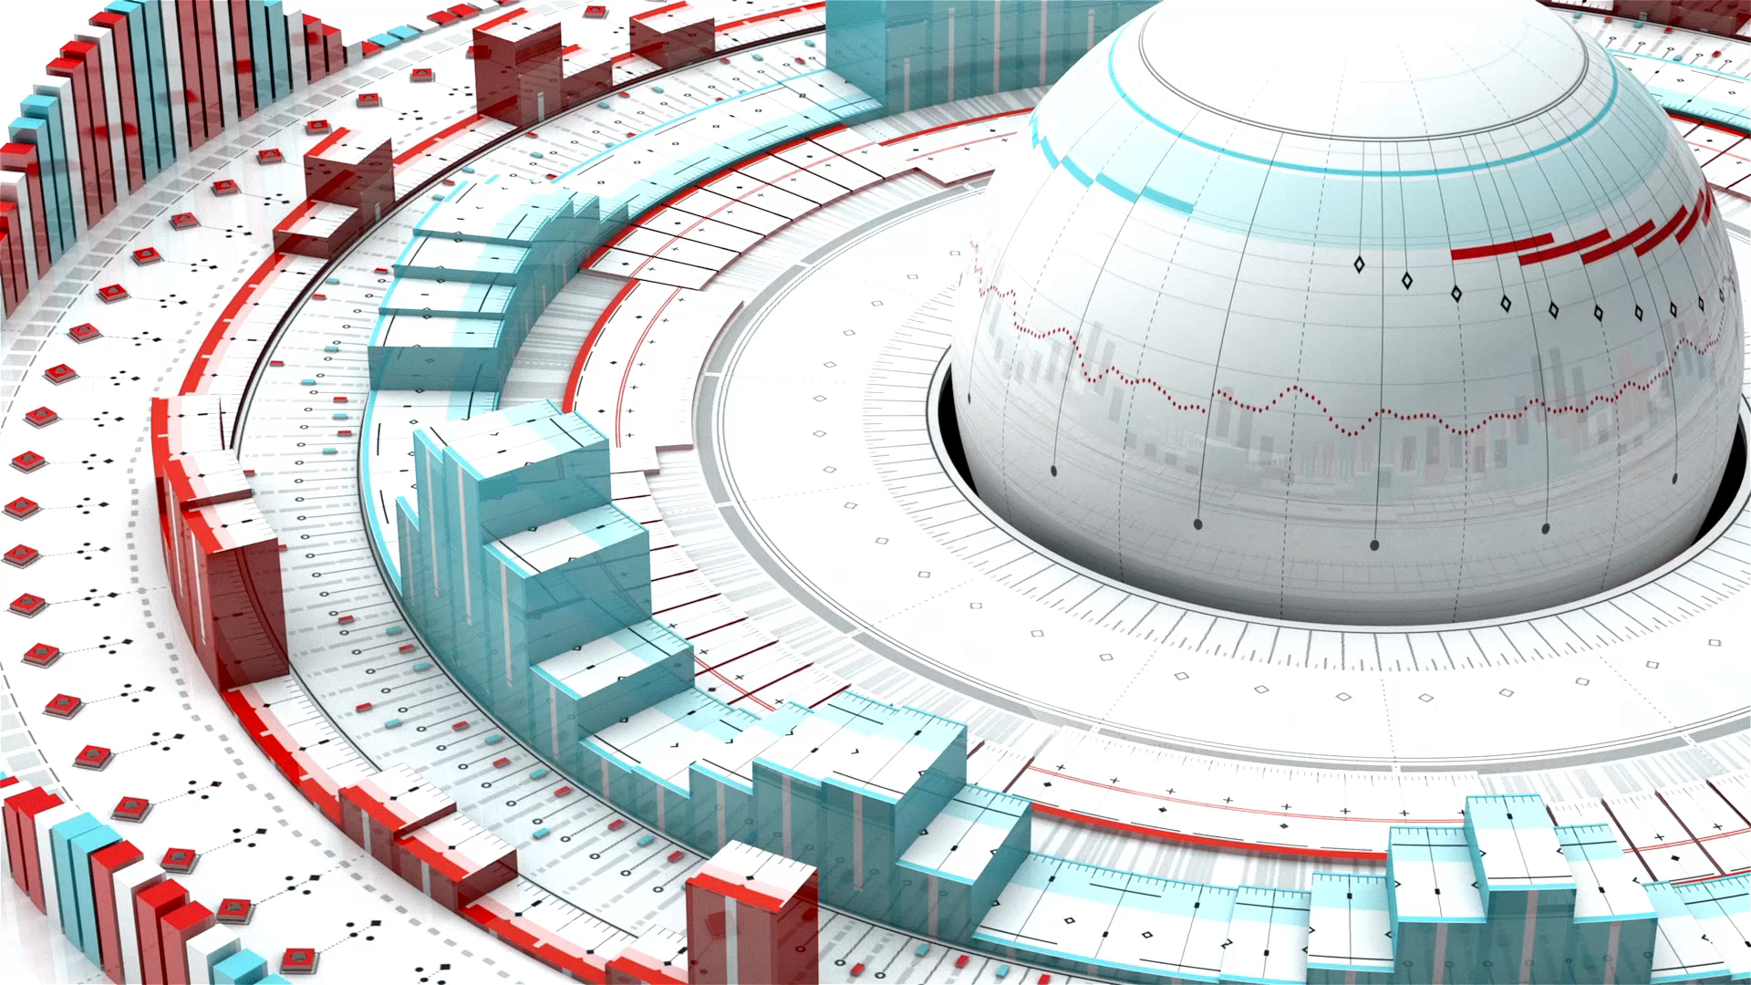
AI Trading Bot
Made by –
Akhilesh Tawte – 21070149026
Gaurang Sonkavde – 2107014923
Mohit Patil -21070149031

Slide 2
Project Outline
Introduction
Environment and Agent
MLP LSTM Policy
Improvement using Indicators
Result

Slide 3
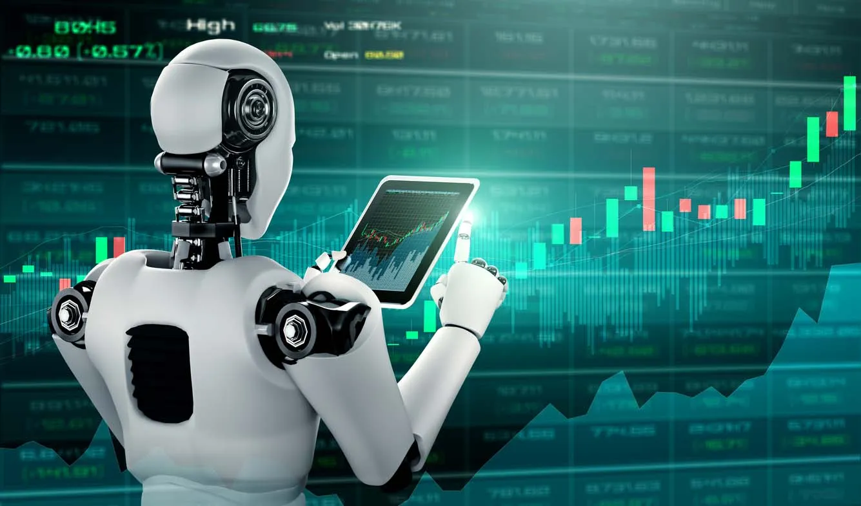
Introduction
Reasoning and Number Crunching useful for Trading and Investing.
Future Direction of Current Stock Prices is derived from Data.
Technology Advancement tries to use ML for Trading by learning Trade Complexity.
RL Based Market Trading Model is used Trading and Trading Environment is created using Open AI Gym

Slide 4
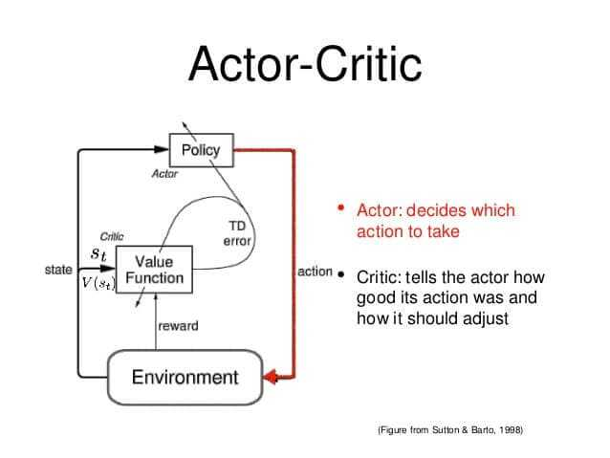
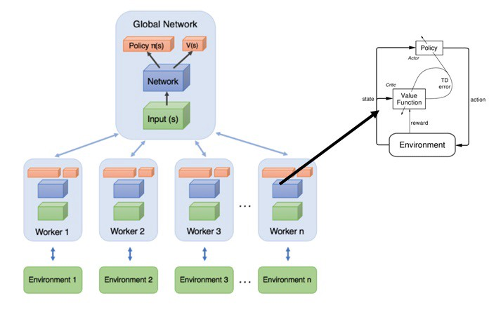
Environment and Agent
AnyTrading is Open Source Collection of Open AI Gym Environments
Used for Trading Algorithm in Forex and Stock Market and provides Gym Environments and used in RL based Algorithms when Trading.
Can be used on three Gym Environments which are TradingEnv , ForexEnv and StockEnv.
A2C ( Advantage Actor Critic) has 2 Variants Asynchronous Advantage Actor Critic (A3C) and Advantage Actor Critic (A2C).
Critic - Estimates the value function. This could be the action-value (the Q value) or state-value (the V value).
Actor - Updates the policy distribution in the direction suggested by the Critic (such as with policy gradients).
A2C is like A3C but without the asynchronous part; this means a single-worker variant of the A3C.

Slide 5
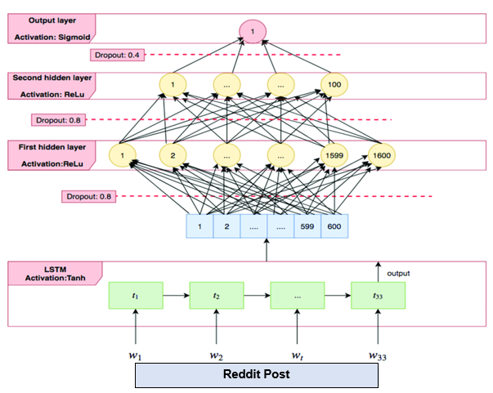
MLp-LSTM Policy
For Deep Neural Network we have used MLP which has LSTM layer
Also it allows Neural Network to keep context and learn about previous history

Slide 6
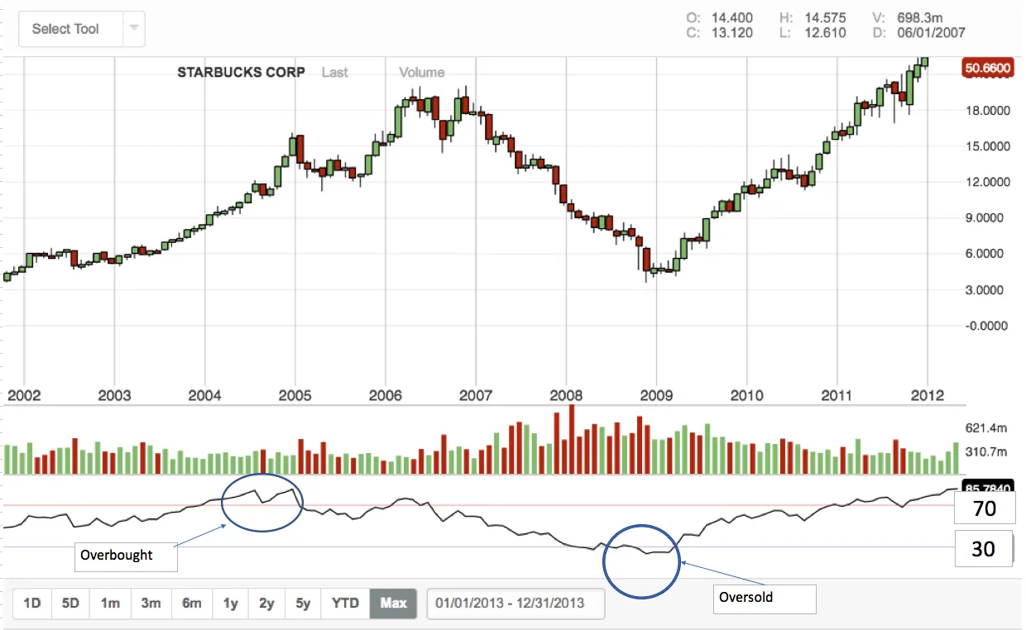
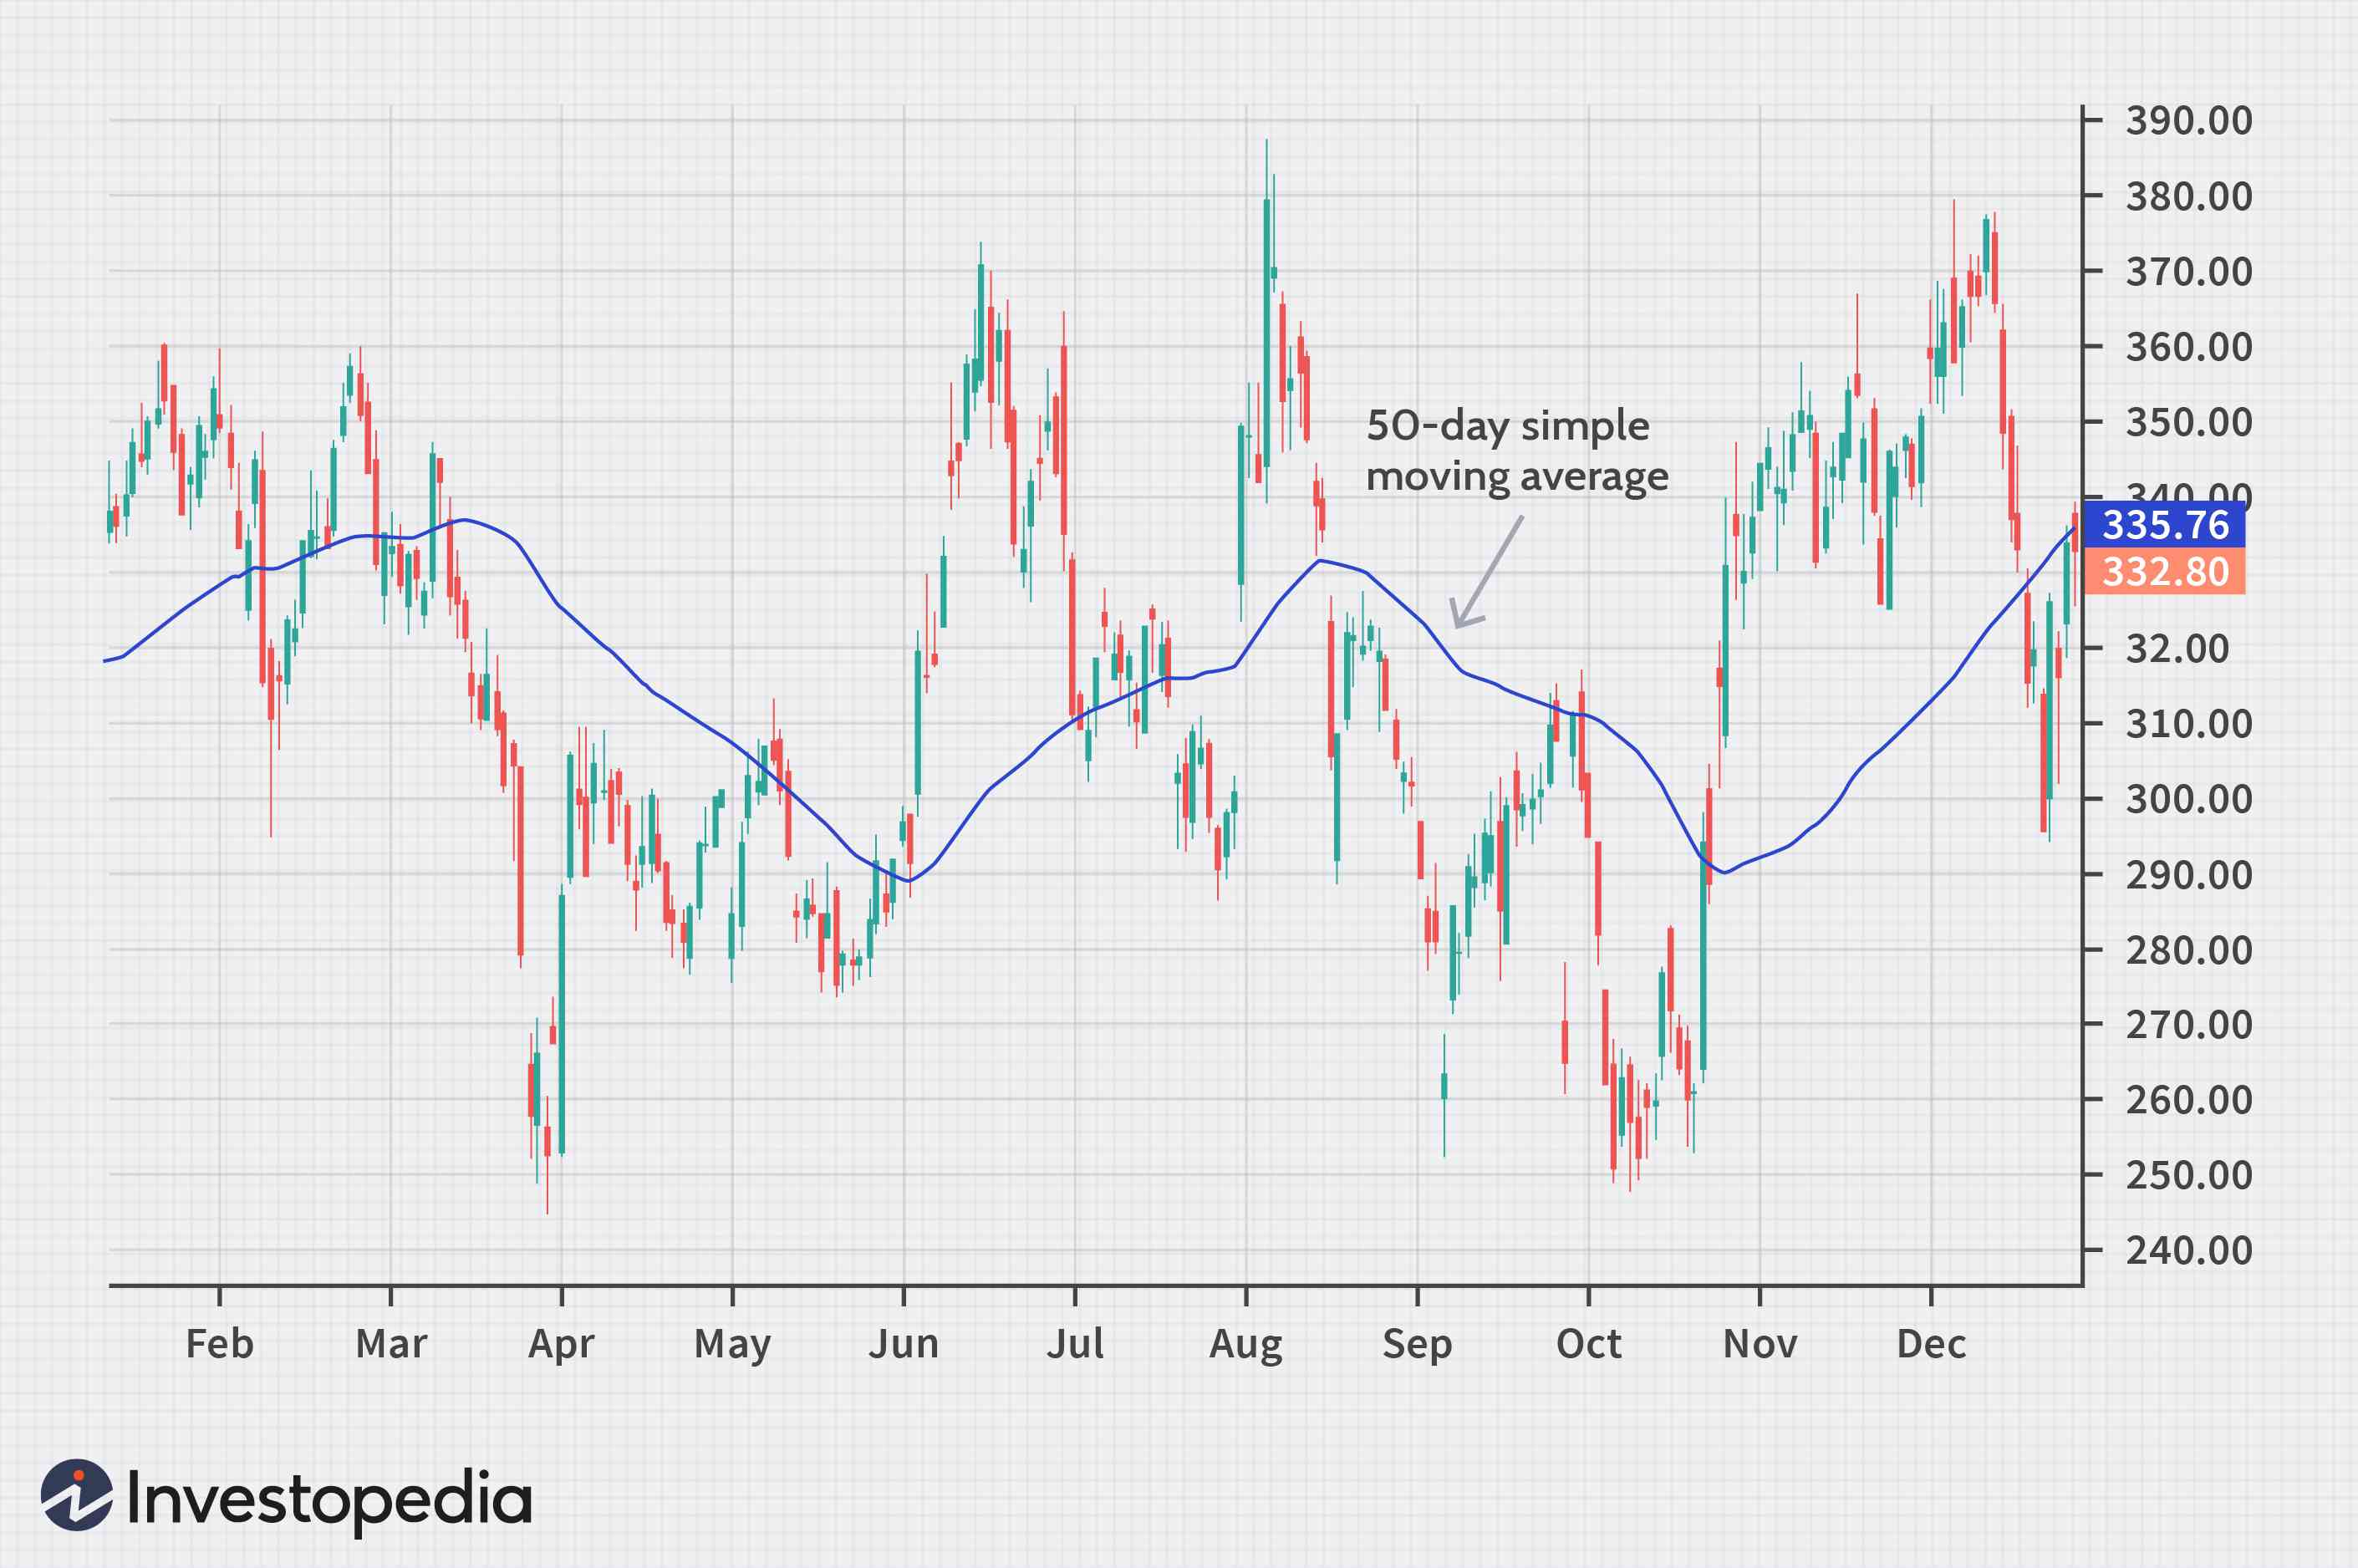
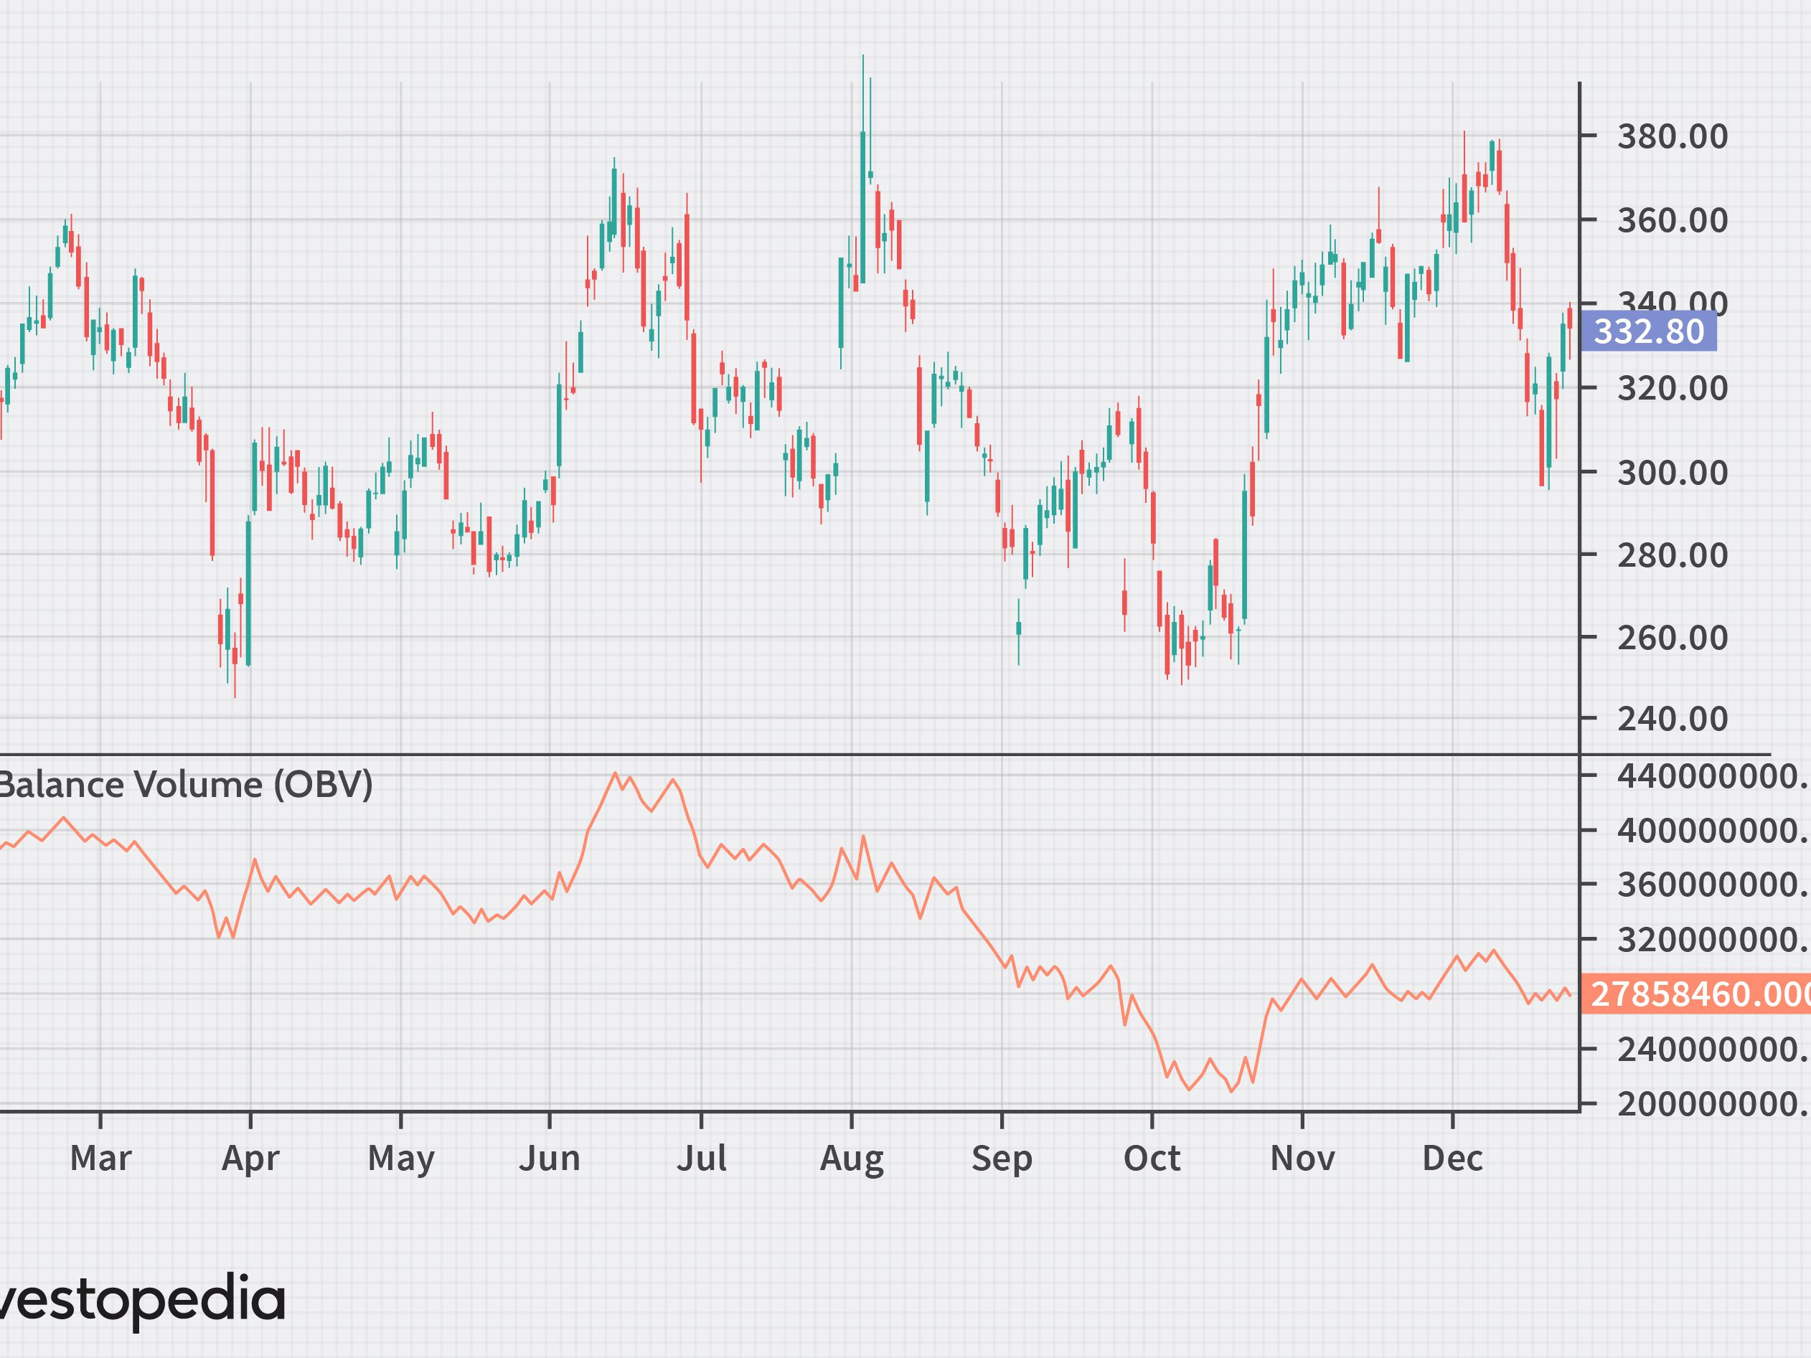
Improvement Using indicators
For Better Accuracy we used Custom Financial Technical Indicators.
We used Indicators
Relative Strength Index (RSI)
Simple Moving Average (SMA)
On-Balance Volume (OBV)
This Indicators we used to Train Reinforcement Learning Model for better Accuracy ang High Profits.

Slide 7
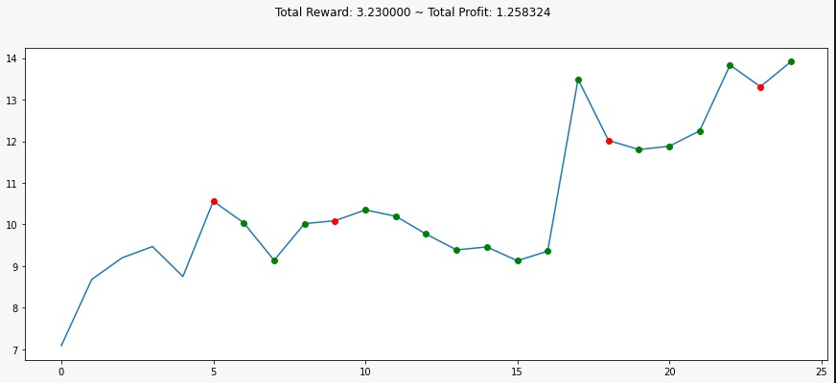
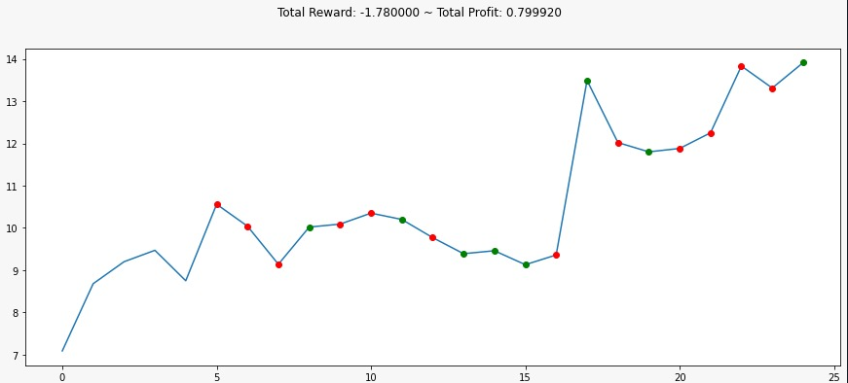
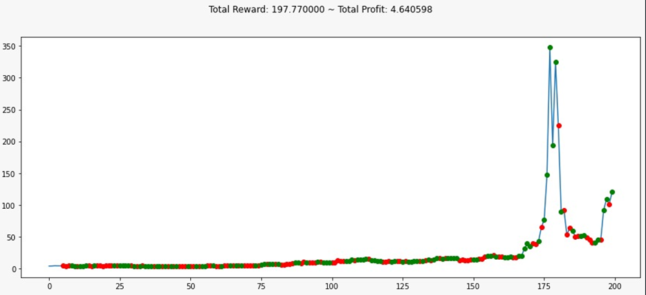
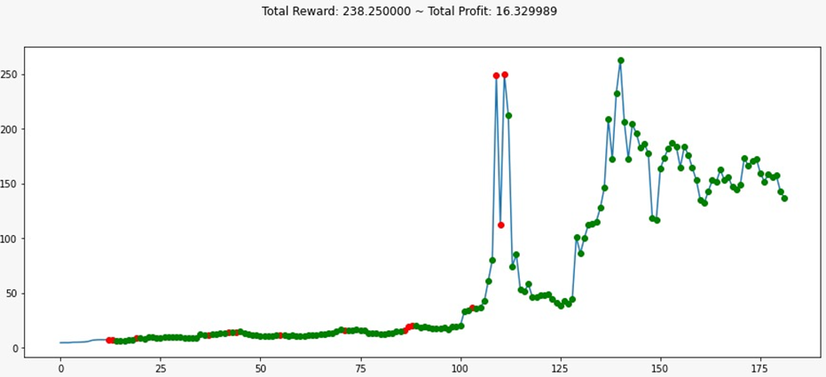
Results
Random Decision without Model
Decision making with Model
Without indicators on Trained Model
Decision making with Indicators and Model

Slide 8

Thank You..!!

